Slide 1
L. 13. Subtractive hybridization Methods
RNA Seq

Slide 2
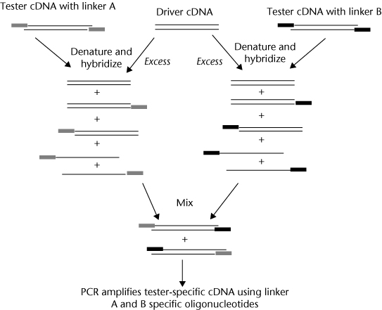
Subtractive hybridization Methods

Slide 3
Techniques that are higher plex
Serial Analysis of Gene Expression (SAGE)
SAGE is a technique used to create a library of short sequence tags which can each be used to detect a transcript.
The expression level of the transcript can be determined by assessing how many times each tag is detected.
This technology enables comprehensive expression analysis across the genome.

Slide 4
The SAGE method
is based on the isolation of unique sequence tags (9-10 bp in length) from individual mRNAs and concatenation of tags serially into long DNA molecules for a lump-sum sequencing.
The SAGE method can be applied to the studies exploring virtually any kinds of biological phenomena in which the changes in cellular transcription are responsible.
SAGE is a highly competent technology that can not only give a global gene expression profile of a particular type of cell or tissue, but also help us identify a set of specific genes to the cellular conditions by comparing the profiles constructed for a pair of cells that are kept at different conditions.

Slide 5
We present an outline of the original method, several studies achieved by using the method as a major strategic tool, technological difficulties and intrinsic problems that emerged, and improvements and modifications of the method to cope with these drawbacks.
We then present our modified SAGE procedure that generates longer sequence tags (14 bp) rather in detail, and the profile (80K profile) derived from HeLa cells that is composed of 80000 tags obtained from a single library.

Slide 6
In addition, a series of smaller profiles (2, 4, 10, 20 and 40K) was made by dividing the 80K profile.
When we compared these smaller profiles with respect to tag counts for a number of genes, it became apparent that counts of most gene tags increase stably and constantly as the size of profiles increase, while several genes do not.
This may be another problem we have to keep in mind, when the profiles are compared for the identification of 'specific genes'.

Slide 7
DNA microarray
Also known of as biochip or DNA chip, a DNA microarray is a solid surface to which a collection of microscopic DNA spots are attached.
The microarrays are used to determine expression levels across a large number of genes or to perform genotyping across different regions of a genome

Slide 8
RNA Seq
This refers to methods used to measure the sequence of RNA molecules.
Examples include shotgun sequencing of cDNA molecules acquired from RNA through reverse transcription and technologies used to sequence RNA molecules from a biological sample so that the primary sequence and abundance of each RNA molecule can be determined.

Slide 9
Differential Display (DD)
Basic idea:
– Run two RNA (cDNA) samples side by
side on a gel
– Excise and sequence bands present in
one lane, but not the other
• The clever trick: (Умный трюк)
– Reduce the complexity of the samples by
making the cDNA with primers that will
prime only a subset of all transcripts

Slide 10
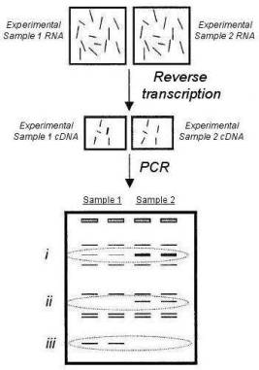
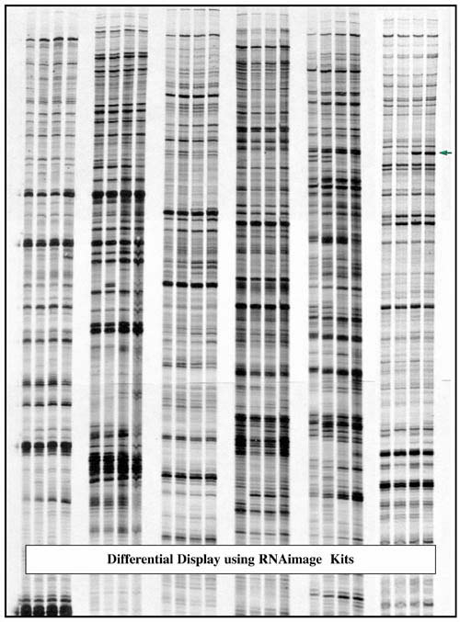

Slide 11
Prime with polyT TAAAAAn GAAAAAn CAAAAAn TAAAAAn | Prime with C(polyT) TAAAAAn GAAAAAn CAAAAAn TAAAAAn

Slide 12
Differential Display (Detail)
prime with polyT
TAAAAAn
TTTTTn
GAAAAAn
TTTTTn
CAAAAAn
TTTTTn
TAAAAAn
TTTTTn
prime with C(polyT)
TAAAAAn
GAAAAAn
CTTTTTn
CAAAAAn
TAAAAAn
Complex cDNA mixture
Less complex cDNA mixture

Slide 13
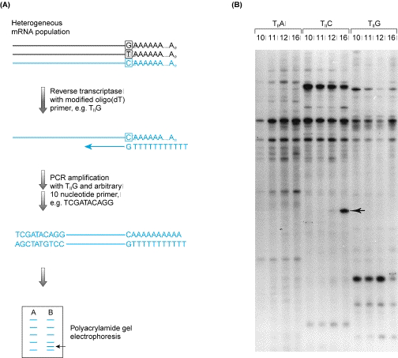
Differential Display (Detail)

Slide 14
Advantages of DD
Oldest of all transcript expression methods
• Technically and technologically simplest of all transcript methods
• Does not require ESTs, cDNA libraries, or any prior knowledge of the genome
• Open-ended technology

Slide 15
Disadvantages of DD
Not very quantitative
• Sensitivity can be an issue
• Only a fraction of the transcripts can be analyzed in any single reaction
• Prone to false positives
• Not easily automated or scaled-up

Slide 16
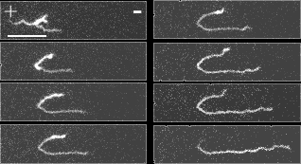
RNA METHODS: ELECTROPHORESIS

Slide 17
PURIFICATION OF MESSENGER RNA USING OLIGO DTCOLUMNS
Break open
cells in the
presence of
RNAse
Inhibitors
Total cellular RNA;
apply at room temperature to
anneal polyA tail to oligo(dT)
Oligo(dT)
attached to
cellulose
AAAA..
TTTT
Isolate RNA
65oC
polyA binds to
oligo(dT) on
column
TTTT
} non-polyA
RNA flows
through
AAAAA.
polyA mRNA elutes at
high temperature

Slide 18
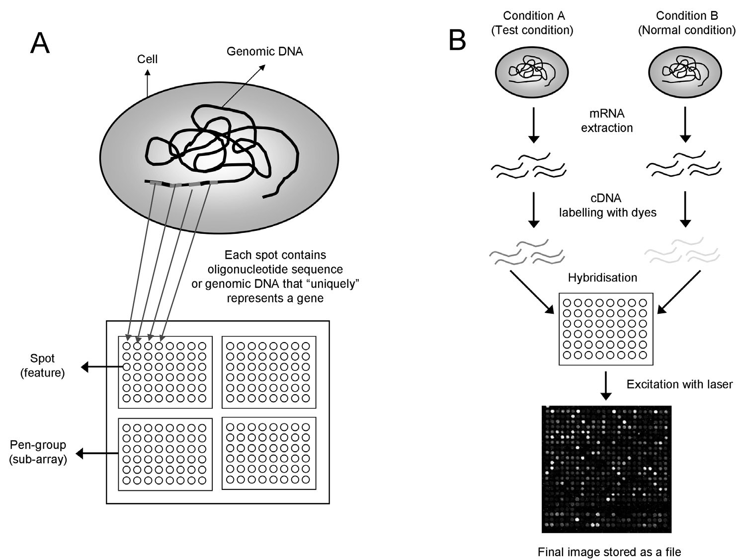
What are microarrays

Slide 19
Advantages and Disadvantages of microarray techniques
Advantages:
Disadvantages:
● Concurrent detection of thousands of genes
● Result is a global answer
● Experiments are fast and easy to perform
● The technique is cost effective
●
Expression differences are relativ
● Cross hybridization is possible
● Data has to be validated by other methods (eg. qPCR)
● Weak expressed genes may not be detected
● Changes in mRNA expression pattern may not effect protein abundance

